Slide 1
Processor Scheduling
Part 2 – Critical Section Problem / Semaphores / Mutex

Slide 2
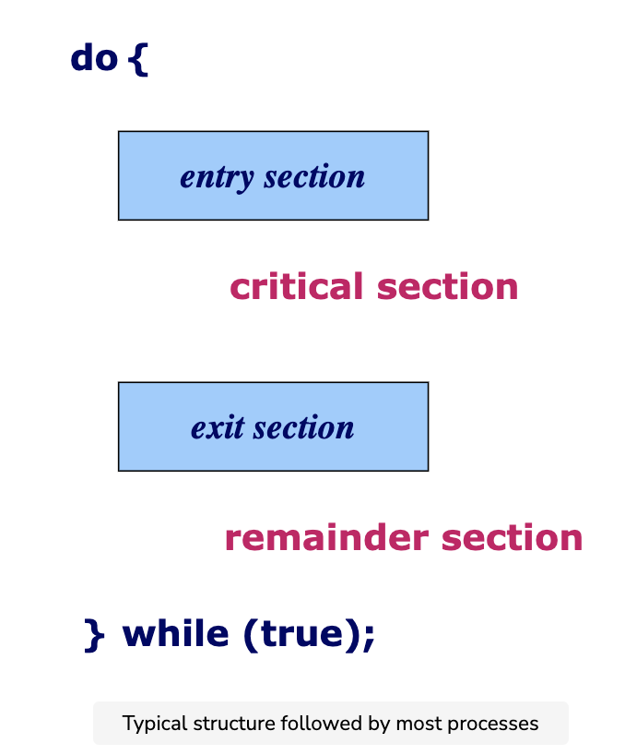
Critical Section Problem

Slide 3
Critical Section Problem
The critical section problem is used to design a protocol followed by a group of processes, so that when one process has entered its critical section, no other process is allowed to execute in its critical section.
The critical section refers to the segment of code where processes access shared resources and perform write operations on them.
These shared resources could be common variables and files.

Slide 4
Critical Section Problem
Since processes execute concurrently (at the same time), any process can be interrupted mid-execution.
In the case of shared resources, partial execution of processes can lead to data inconsistencies.
When two processes access and manipulate the shared resource concurrently, and the resulting execution outcome depends on the order in which processes access the resource; this is called a race condition.
More on race conditions in the next slide

Slide 5
Race Conditions
Two or more processes "race" through the critical section to write or read shared resources and depending on the order in which process finish the "race", the program output changes.
In a race condition, processes access shared resources that might be worked on by other processes at the same time causing the application data to be inconsistent.

Slide 6
Simple Example of a Race Condition
A simple example of a race condition is a light switch.
In some homes, there are multiple light switches connected to a common ceiling light.
When these types of circuits are used, the switch position becomes irrelevant. If the light is on, moving either switch from its current position turns the light off.
Similarly, if the light is off, then moving either switch from its current position turns the light on.
With that in mind, imagine what might happen if two people tried to turn on the light using two different switches at the same time.
One instruction might cancel the other or the two actions might trip the circuit breaker.

Slide 7
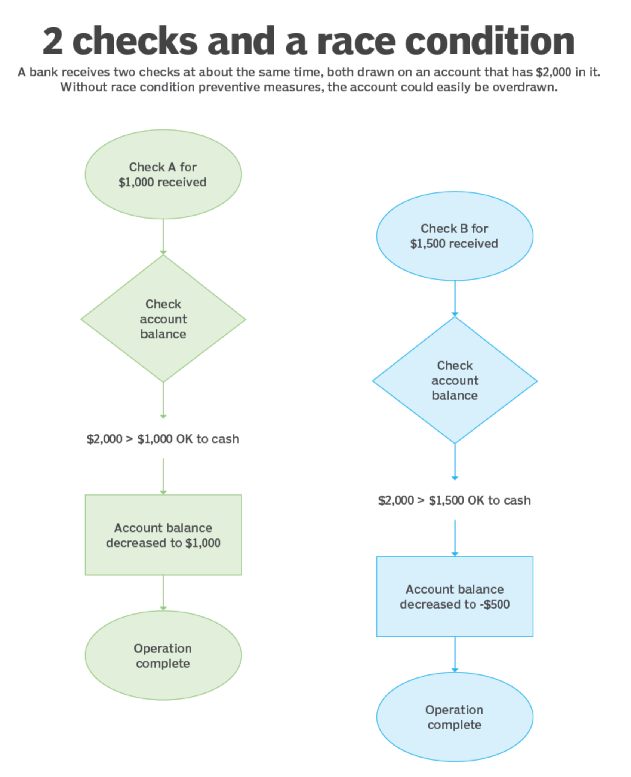
Another Example
See how a race condition could develop if a bank receives two checks -- one for $1,000 and the other for $1,500 -- at about the same time, both drawn against a checking account with only $2,000 in it.

Slide 8
Solutions to the Critical Section Problem
Any solution to the critical section problem must satisfy the following requirements:
Mutual exclusion: When one process is executing in its critical section, no other process is allowed to execute in its critical section.
Progress: When no process is executing in its critical section, and there exists a process that wishes to enter its critical section, it should not have to wait indefinitely to enter it.
Bounded waiting: There must be a bound on the number of times a process is allowed to execute in its critical section, after another process has requested to enter its critical section and before that request is accepted.

Slide 9
Semaphore

Slide 10
What is a Semaphore
A semaphore is a variable that is used to allow process synchronization.
A semaphore allows two processes to exclusively run their critical section. This means that each process can run the non-mutual code (the code that is not shared between the two processes) alone. This also allows maximum processor power and zero interruption from the other processes.
A semaphore can have a value of 1 or 0.

Slide 11
How it works
Suppose that two processes exist (i.e., process A and process B).
If A enters into its critical section, it makes the semaphore s = 0.
If B wants to enter into its critical section, then it will have to wait for the moment when s becomes positive (i.e., s > 0) which will only happen if A finishes its critical section and calls the signal() function to increment the value of semaphore s.

Slide 12
Two Operations
A semaphore has two operations:
wait();
signal();

Slide 13
wait()
This operation decrements the value of the semaphore by 1
i.e., s = s -1

Slide 14
signal()
This operation increments the value of the semaphore by 1
i.e., s = s + 1;

Slide 15
Mutex

Slide 16
What is a Mutex
Mutex stands for Mutual Exclusion Object.
Mutex is a particular kind of binary semaphore that is applied to control access to the share.
The word "mutex" stands for an object providing MUTual EXclusion between processes.
Mutex ensures that only one thread has access to a critical section or data by using operations like a lock and unlock.
A process having the lock of mutex can use the critical section while other threads must wait till the lock is freed

Slide 17
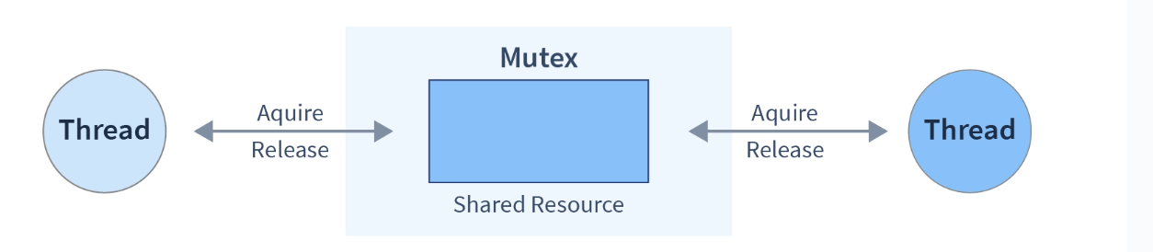
Advantages of Mutex
Advantages of Mutex
Mutexes are nothing more than basic locks that must be obtained prior to entry in a critical section and subsequently released.
Absence of race situations since a single thread is in the crucial region at a particular time, and data consistency is there.

Slide 18
Mutex vs Semaphore
Parameters | Semaphore | Mutex
Mechanism | It is a type of signalling mechanism. | It is a locking mechanism.
Data type | Semaphore is an integer variable. | Mutex is just an object.
Modification | The wait and signal operations can modify a semaphore | It is modified only by the process that may request or release a resource.
Resource management | If no resource is free, then the process requires a resource that should execute wait operation. It should wait until the count of the semaphore is greater than 0. | If it is locked, the process has to wait. The process should be kept in a queue. This needs to be accessed only when the mutex is unlocked.
Thread | You can have multiple program threads. | You can have multiple program threads, but not simultaneously.
Ownership | Value can be changed by any process releasing or obtaining the resource. | Object lock is released only by the process, which has obtained the lock on it.
Types | Types are "counting semaphore" and "binary semaphore". | Mutex has no subtypes.
Operation | Semaphore value is modified using wait() and signal() operation. | Mutex object is locked or unlocked.
Resources occupancy | It is occupied if all resources are being used and the process requesting for resource performs wait() operation and blocks itself until semaphore count becomes >1. | In case if the object is already locked, the process requesting resources waits and is queued by the system before lock is released.
https://www.guru99.com/mutex-vs-semaphore.html

Slide 19
Starvation:

Slide 20
What is a starvation problem in an operating system?
Starvation happens if a method is indefinitely delayed. This can emerge once a method needs a further resource for execution that isn’t assigned.
These resources are things like:
CPU time
Memory
Disk space
I/O access to network or disk
Starvation is the problem that occurs when low priority processes get jammed for an unspecified time as the high priority processes keep executing.

Slide 21
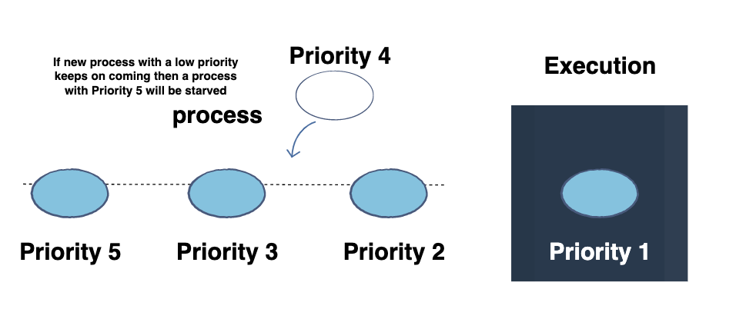
What is a starvation problem in an operating system?
A steady stream of higher-priority methods will stop a low-priority process from ever obtaining the processor.

Slide 22
Measures to handle starvation
The resource allocation will be taken by a freelance manager to ensure even distribution.
The criteria for priority of resource allocation ought to take into account factors like aging to prevent starvation.
Random choice of processes for resource allocation or processor allocation ought to be avoided as they encourage starvation.

Slide 23
Differences between Starvation and Deadlock
Starvation | Deadlock
1. It is called lived stock. | 1. It is called circular waiting.
2. Starvation occurs when a process requires a resource for execution that it is never allowed. | 2. A deadlock occurs when two or more processes need some resource to complete the execution held by the other process.
3. Starvation is more of a scheduler issue. | 3. Deadlock is more of a process design/distributed design issue.

